Slide 2
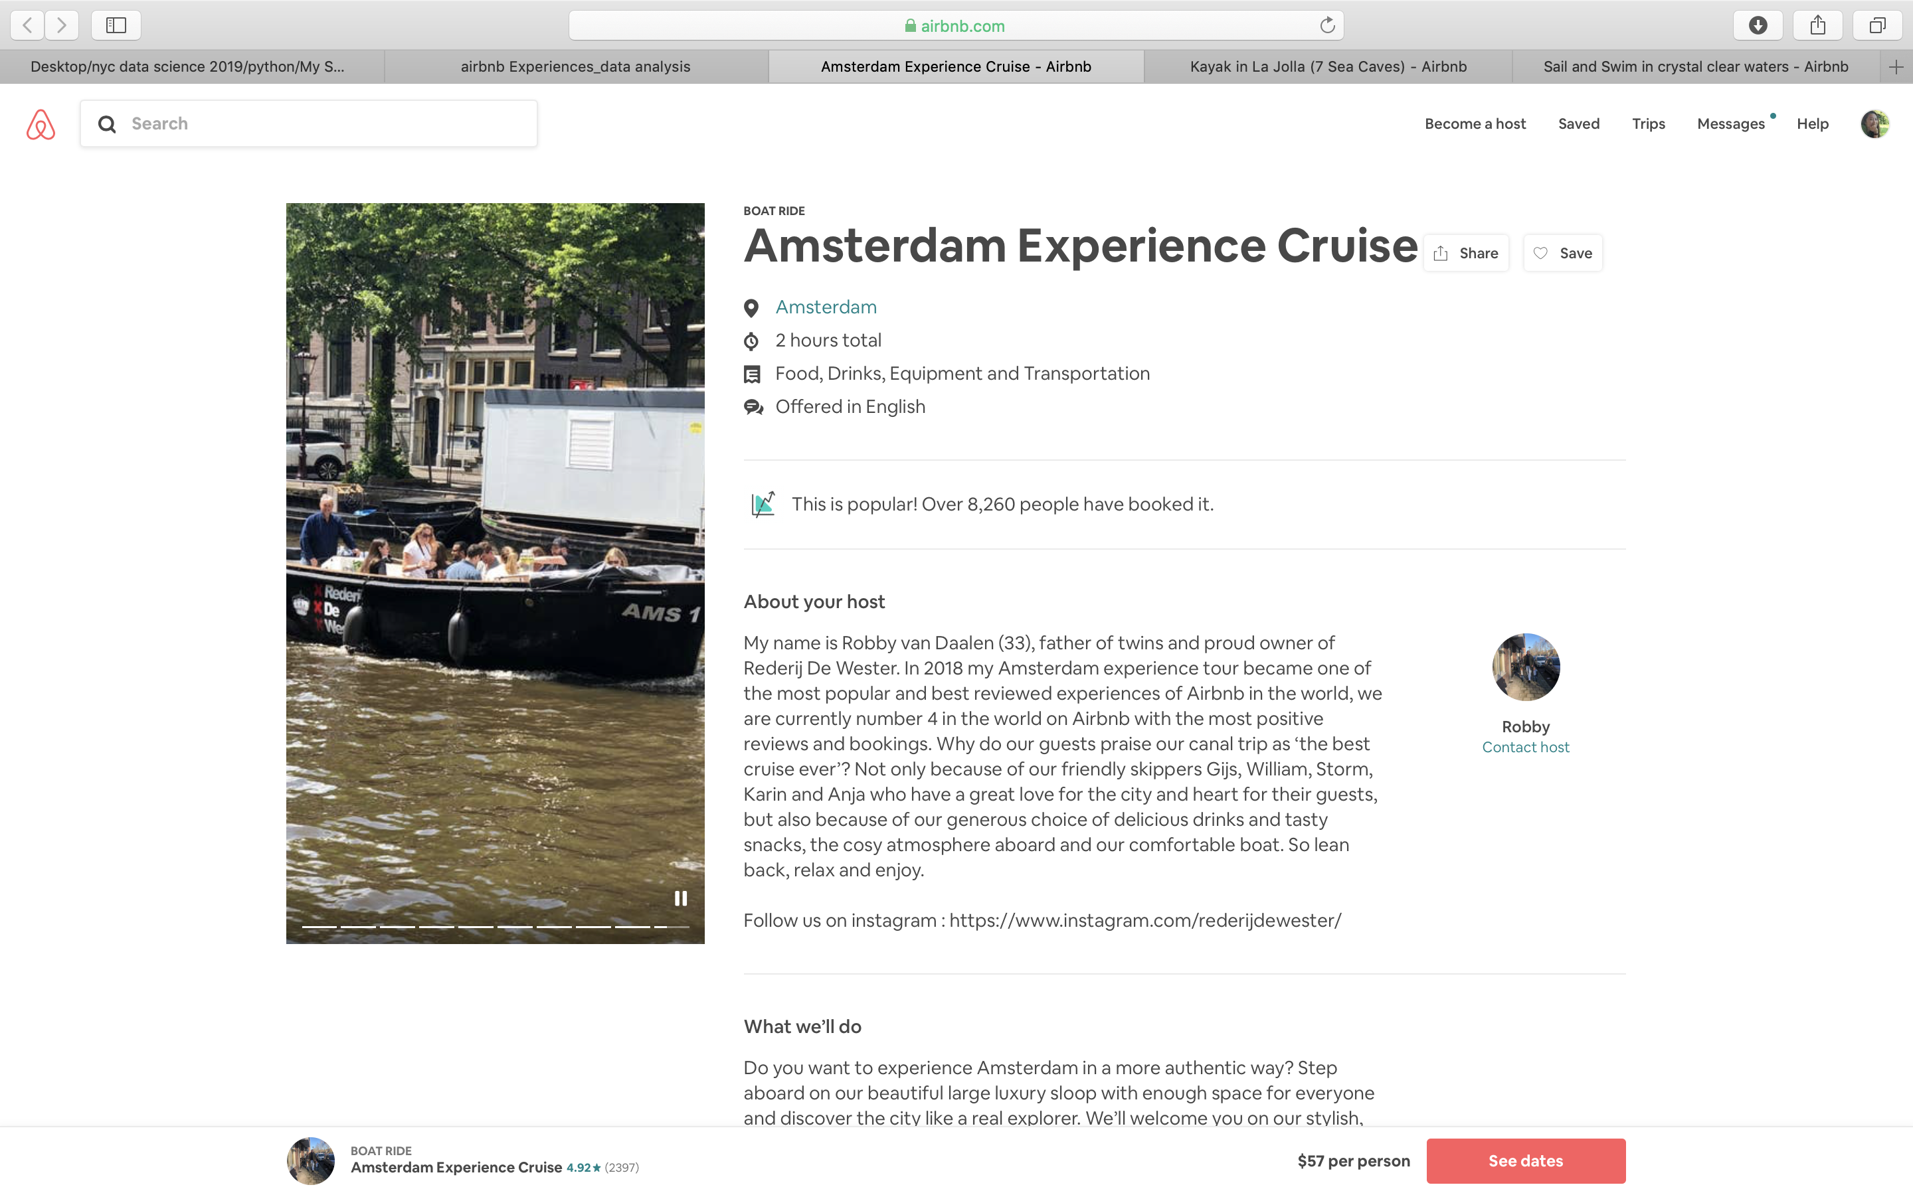
Business model:
20% of listing price to Airbnb

Slide 3
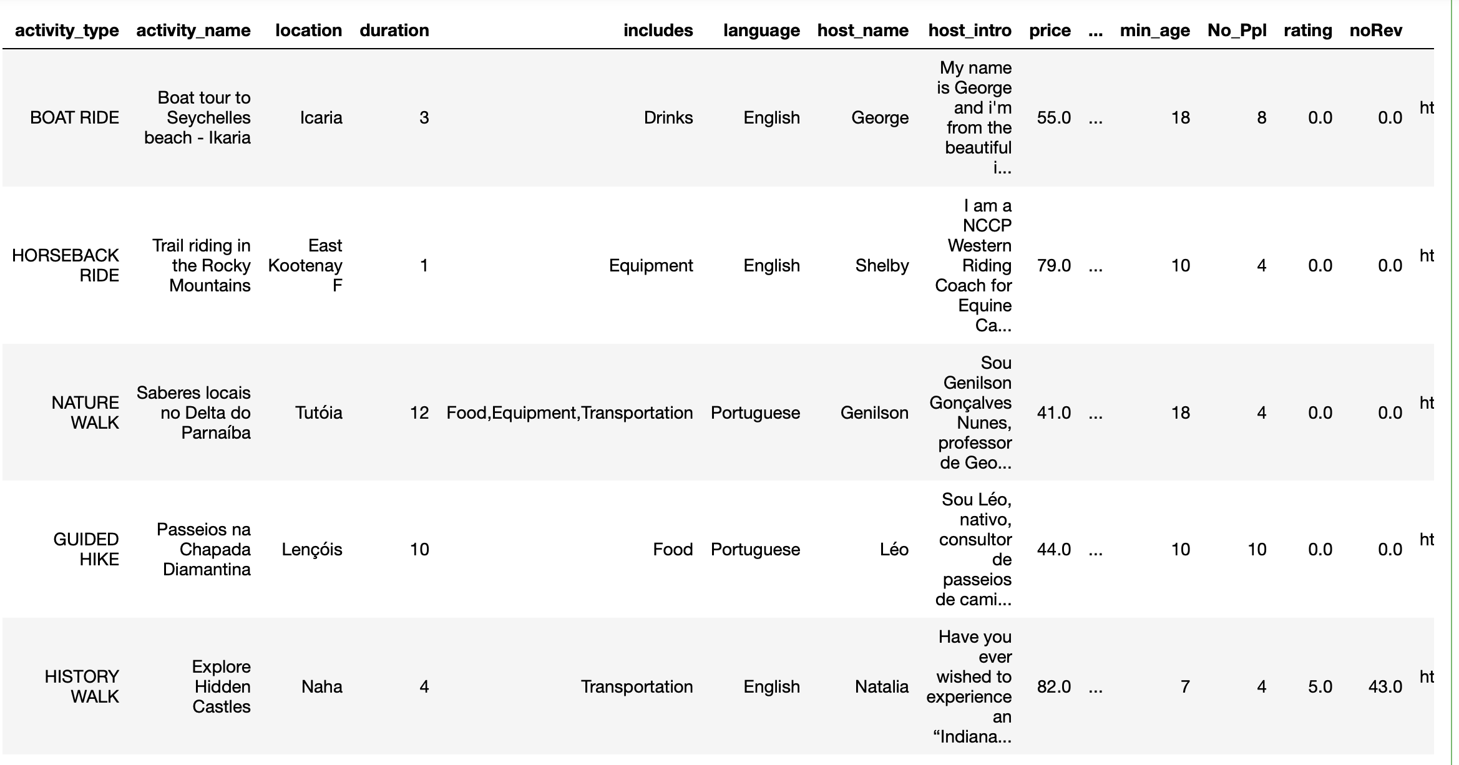
981 listings

Slide 4
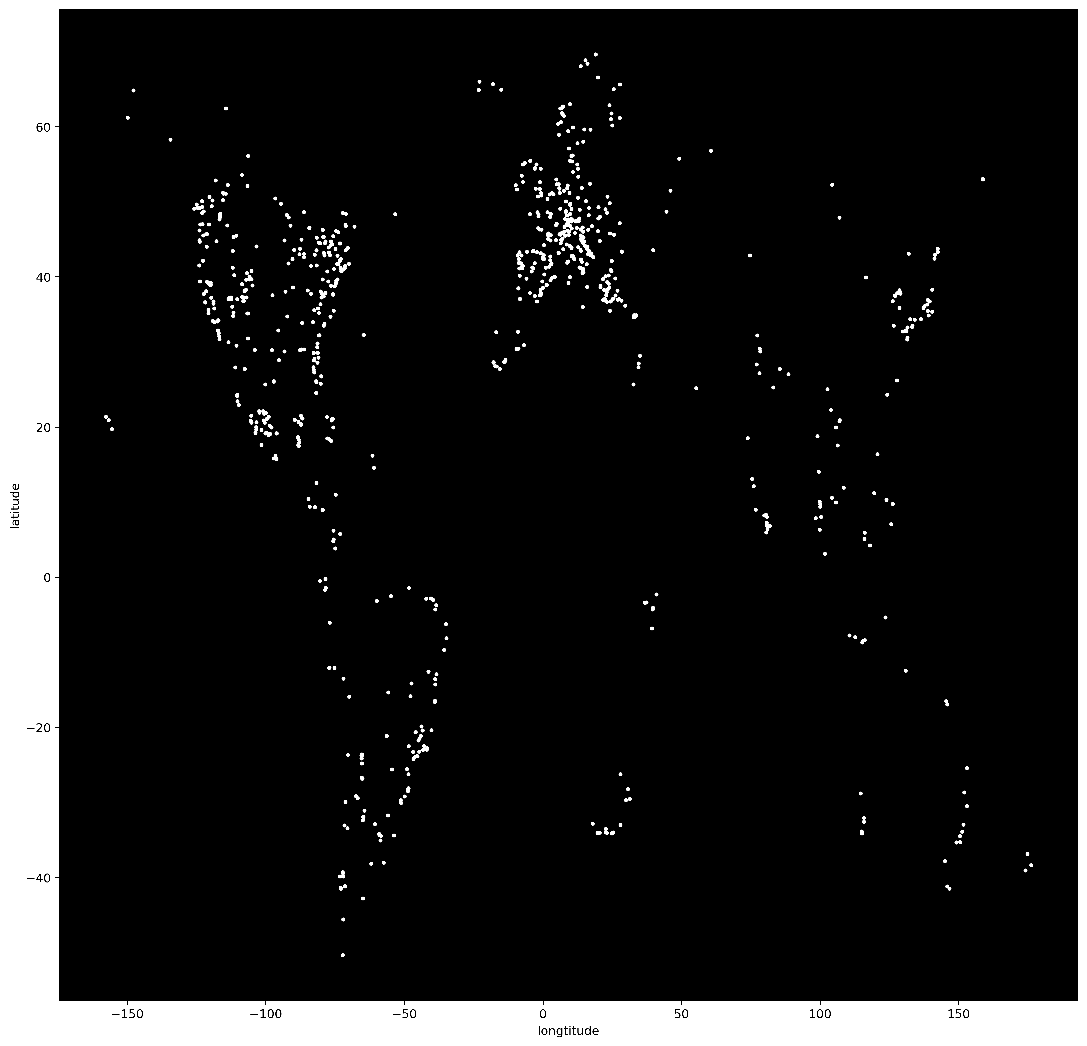
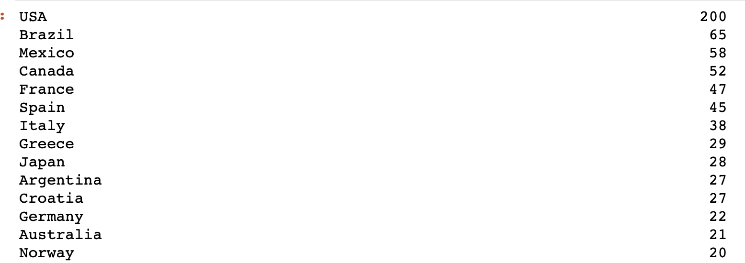
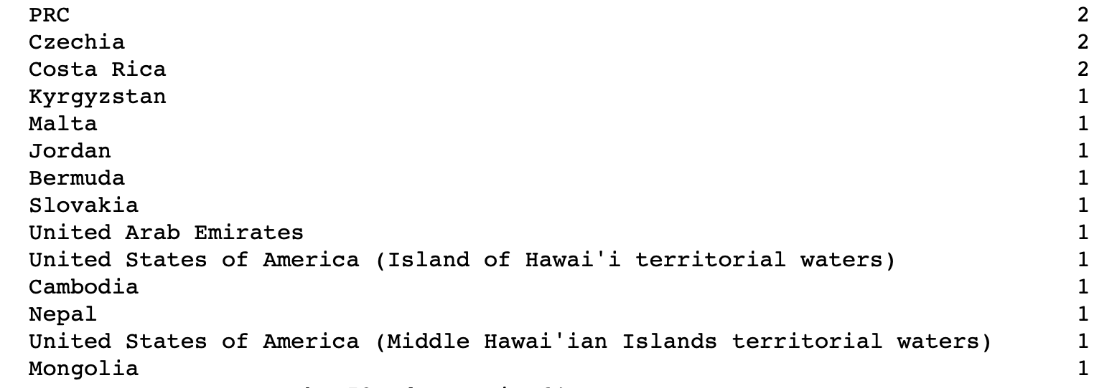

Slide 5
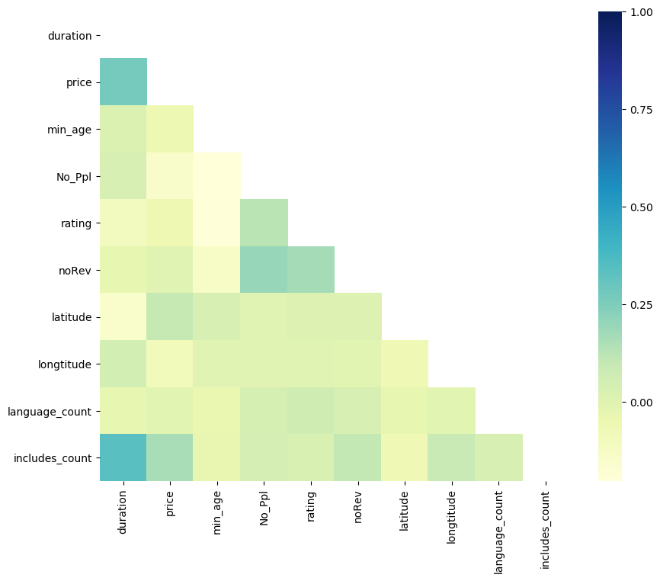
Unfortunately, no significant correlation found.
→ Linear model doesn’t fit this situation.

Slide 6
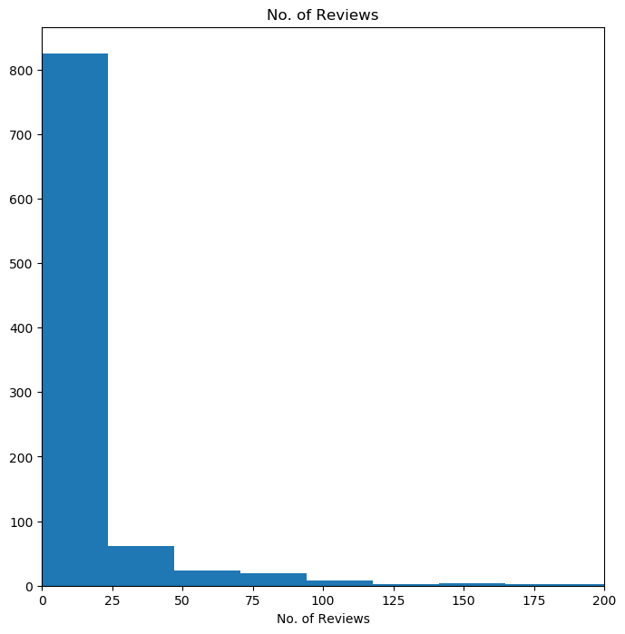
Sales performance of most of the listings is not impressive.
→ Potential to improve

Slide 7
Ratings range from 4 to 5.
→ Quality of experiences is very good.

Slide 8
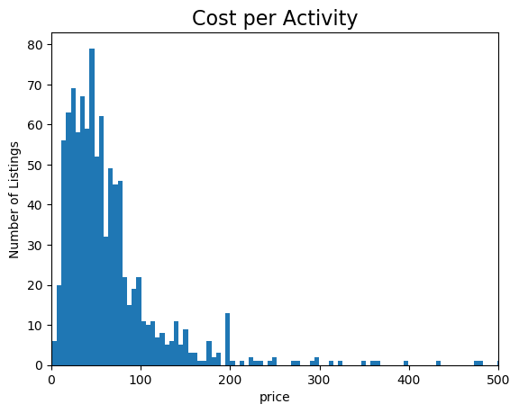
A majority of experience listings is under $150.
T-test!

Slide 9
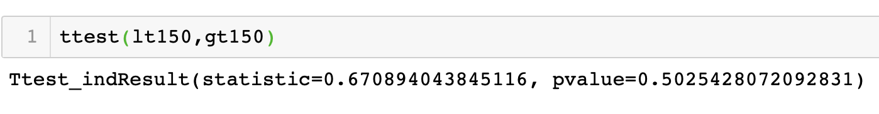

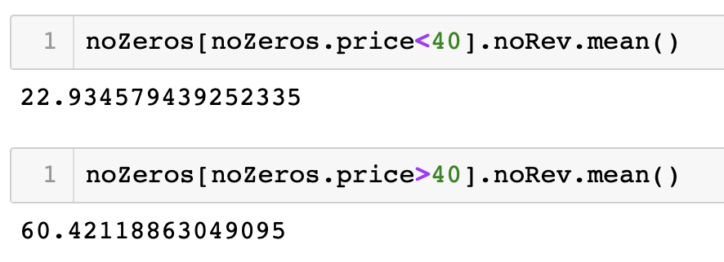
Min p-value = 0.7%
Price = $40

Slide 11
Top 4 most popular activity type:
Boat trip
Guided hike
Kayaking
Day trip

Slide 13
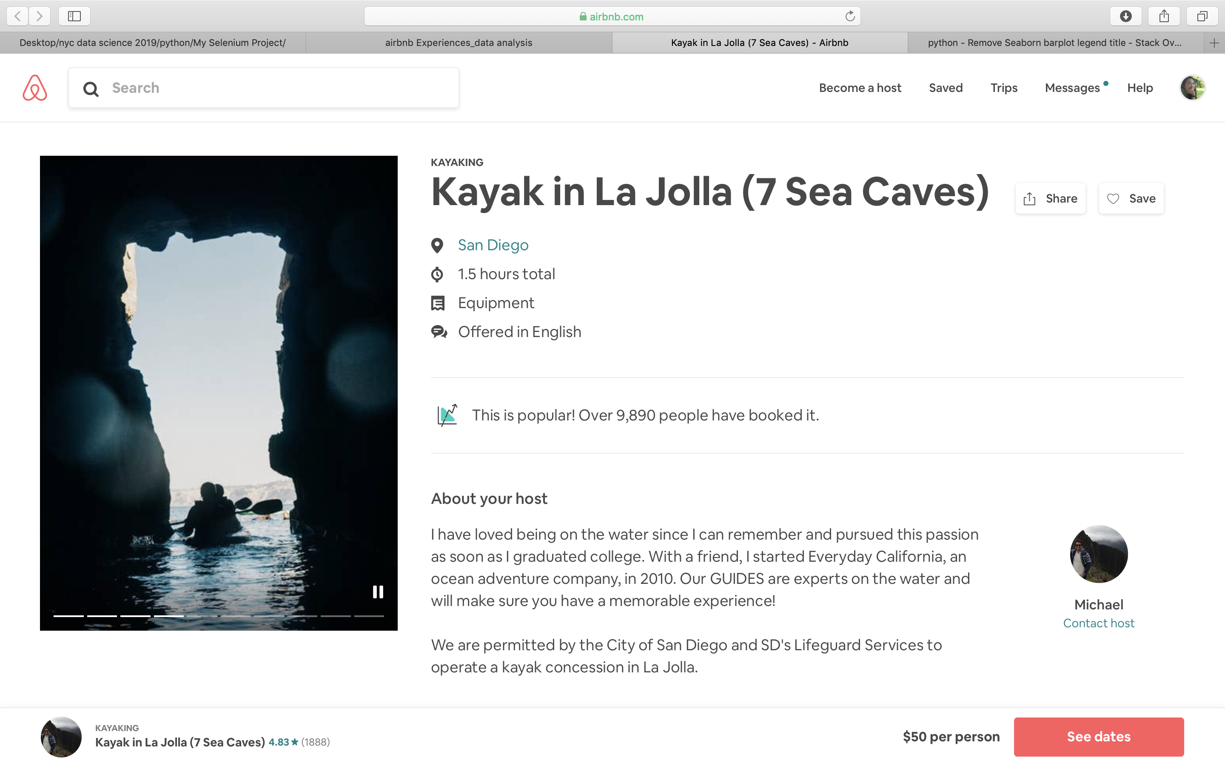
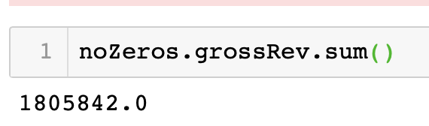
Revenue Estimate
Sales multiple = 5 times

